Slide 1
Norway
Child Rights and child protection interventions
A chapter by
Asgeir Falch-Eriksen, Marit Skivenes & Karl Harald Søvig

Slide 2
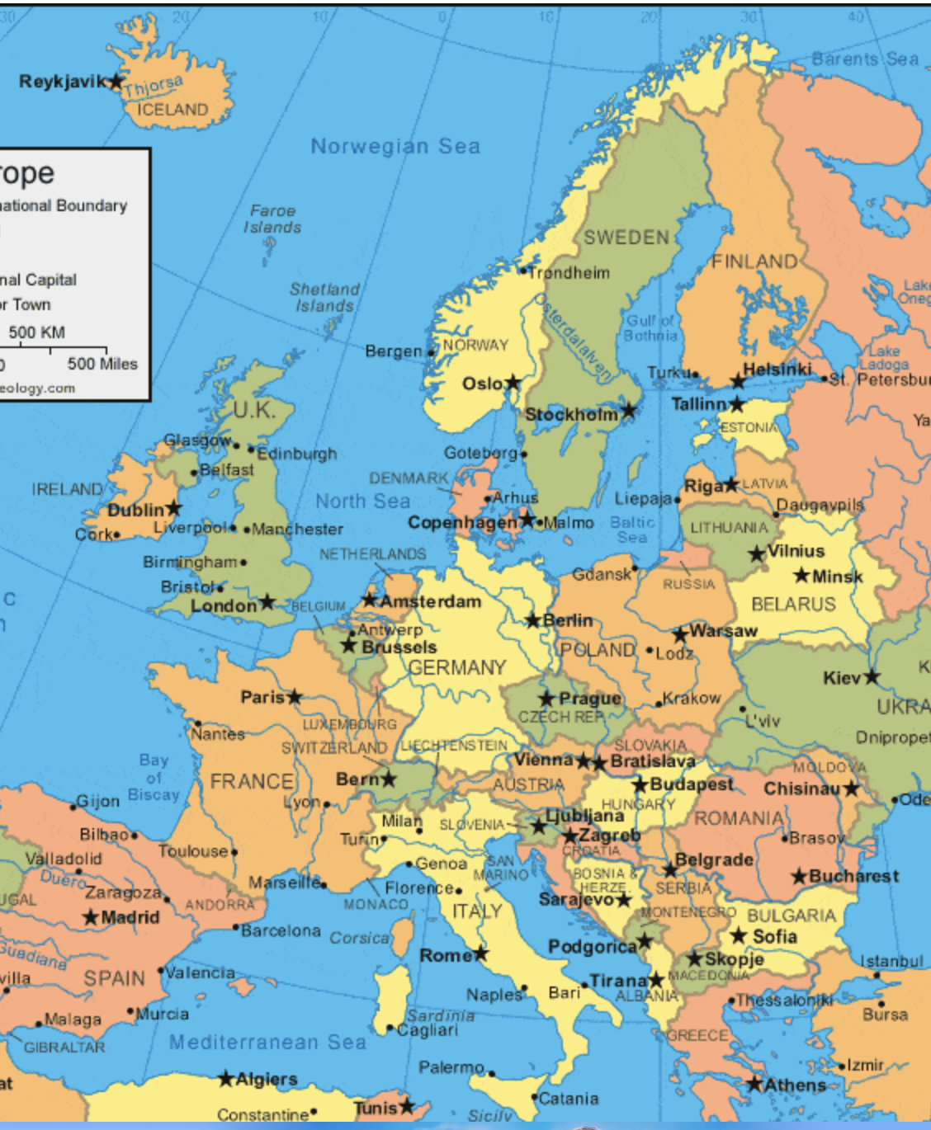
Norway
Per January 2026 there are a total population of 5,627,400 individual in Norway, of which the child population (0–17 years) is 1,101,380.

Slide 3
Child protection agancy prepare removals
It is Child Protection Services (CPS) at municipality level that are responsible for implementing the aims set out in the child protection law and to prepare cases for the tribunal.
Per 2026 there are 357 municipalities. The municipalities vary in population size, with half having less that 5,000 inhabitants (174), 22% has around 2-4,000 inhabitants, and 2% (8) have over 100,000 inhabitants (SSB, 2026).
There can be large geographical distances in Norway, and inter municipality collaboration is in place for 213 municipalities.

Slide 4
Child Welfare Tribunal decides (most) removals
Care orders and any intrusive intervention are decided by the Child Welfare Tribunal (Tribunal).
There are 12 Boards, each responsible for a region of Norway.
Both the municipality and the private parties can challenge the decision of the Board before the district courts,
and further to the appeal court and to the supreme court (for both the latter only on selected criteria).

Slide 5
The term child protection system refers to systems described in CRC Article 19, 2 section, in which governments establish a system that is responsible for children at risk of harm or neglect from their parents or caregivers, or at risk of harming themselves or others
Within a global typology of child protection systems, the Norwegian system has for a long time been regarded as child rights oriented (Berrick et al., 2023; Gilbert et al., 2011).
The Convention on the Rights of the Child (CRC, 1989) is incorporated into Norwegian law and further strengthened by the constitutional amendment of Article 104, and additional legislative reforms.

Slide 6
Constitution, Article 104
Children have the right to respect for their human dignity. They have the right to be heard in questions that concern them, and due weight shall be attached to their views in accordance with their age and development.
For actions and decisions that affect children, the best interests of the child shall be a fundamental consideration.
Children have the right to protection of their personal integrity. The authorities of the state shall create conditions that facilitate the child’s development, including ensuring that the child is provided with the necessary economic, social and health security, preferably within their own family.

Slide 7
Constitution, Article 104
Children have the right to respect for their human dignity. They have the right to be heard in questions that concern them, and due weight shall be attached to their views in accordance with their age and development.
For actions and decisions that affect children, the best interests of the child shall be a fundamental consideration.
Children have the right to protection of their personal integrity.
The authorities of the state shall create conditions that facilitate the child’s development, including ensuring that the child is provided with the necessary economic, social and health security, preferably within their own family.

Slide 8
§ 1-4 The child's right to participation
A child who is capable of forming their own views has the right to participate in all matters concerning the child under this Act. Children have the right to speak with child welfare services regardless of parental consent, and without parents being informed of the conversation in advance. The child shall receive sufficient and adapted information and has the right to express their views freely. The child shall be heard, and the child's views shall be given weight in accordance with the child's age and maturity.
Children shall be informed of what information they provide may be used for and who may have access to that information. The child has the right to express their views before it is decided that the information will be shared, and the child's views shall be given weight in accordance with their age and maturity.
In meetings with child welfare services, a child may be given the opportunity to bring a person they particularly trust. That trusted person may be required to maintain confidentiality.

Slide 9
§ 1-4 The child's right to participation
A child who is capable of forming their own views has the right to participate in all matters concerning the child under this Act. Children have the right to speak with child welfare services regardless of parental consent, and without parents being informed of the conversation in advance. The child shall receive sufficient and adapted information and has the right to express their views freely. The child shall be heard, and the child's views shall be given weight in accordance with the child's age and maturity.
Children shall be informed of what information they provide may be used for and who may have access to that information. The child has the right to express their views before it is decided that the information will be shared, and the child's views shall be given weight in accordance with their age and maturity.
In meetings with child welfare services, a child may be given the opportunity to bring a person they particularly trust. That trusted person may be required to maintain confidentiality.

Slide 10
When may a child be moved?
First, parents may themselves place the child with other carers, for a shorter or longer period
Second, there is voluntary placement, where the CPS places the child with the parents’ consent.
Third, there is emergency placement, used when an acute situation requires immediate protection of the child;
Fourth, the CPS may prepare and submit a care order application to the county board.

Slide 11
1. Private sphere placements
These types of placements are solely rooted in parental authority, and it may be a teenager moving to their aunt for a period or grandparents taking care of their grandchild. It is within the family to decide how to raise their children. The CPS may only have a say if the period exceeds 2 months, and this is justified by a concern that the placement the parents have chosen is not in the child´s interest. This also marks how the government has an independent responsibility for children, and not only via the family.
How are these private sphere placements are for children, we have hardly any knowledge about.
We do not know how many children are concerned, why they are not living with their parents, how they feel about it etc.

Slide 12
2. Voluntary placements
When a child is placed out of home with the consent of the parents, and with the consent of the child where the child has party status.
Voluntary placements are, according to the legislator’s intent, meant to provide support when parents are temporarily unable to provide everyday care. If the placement is expected to be of longer duration, CPS must consider whether a care order should be issues.
The measure of voluntary placement in some respects cuts against the basic structure of the Norwegian child protection system, where the premise is that all serious interventions in family life must follow robust, legally secure procedures and be decided by the Trubunal.
Concerns about child rights: There is reason to ask whether voluntary placements are used in the right situations for the child, and for the right children.
Some children remain in a voluntary placement for a long time, and a high proportion of these cases appear to proceed to care orders which indicate the purpose of the voluntary placement was not there.

Slide 13
3. Emergency placements
To protect children in emergency situation, special assigned personnel may issue an emergency care order when there is a risk that the child will suffer significant harm if the order is not implemented immediately.
Emergency placement may be made with or without the consent of the parents and/or the child.
The child is moved either to an emergency foster home (one fifth), a foster home including kinship or network placements (one fifth), or an emergency institution (three fifths).
After an emergency placement, the child either returns home, possibly with in-home services being implemented, or moves to a foster home or institution, either as a voluntary placement or following a decision by the Tribunal.
Concerns about child rights: There are several serious concerns around the situation for children that are placed out of home on an emergency basis, but there are little data and research.

Slide 14
4. Care orders
A care order case is initiated by an application for measures from the municipality and the CPS.
The CPS prepare and carry out the necessary investigations and casework to ensure that the case is sufficiently documented for the Tribunal to make a decision
A care order can only be issued if “less intrusive measures cannot create satisfactory conditions for the child” and if a care order can be issued “if this is necessary based on the child’s situation”.
In addition, the provisions establish several alternative conditions, which can be divided into main alternative groups. The first main alternative addresses the present situation, and includes:
“serious shortcomings in the care the child is receiving, including personal contact and a sense of security, in light of the child’s needs based on their age and stage of development” (litra a)
that “the parents fail to ensure that a child who is ill, has a disability or has special assistance needs receives the necessary treatment and/or training” (litra b)
that “the child is being mistreated or subjected to other serious abuse at home” (litra c)
Concerns about child rights:
There are concerns that children's rights are not adequately protected in care order proceedings. If solutions are chosen at the expense of the child, and whether the child's participation receives sufficient weight.
This applies especially to children without party status.

Slide 15
Table: Statistics on children and the child protection system
 |  | 2013 | 2014 | 2015 | 2016 | 2017 | 2018 | 2019 | 2020 | 2021 | 2022 | 2023 | 2024
Child population 0-17, end of year, N – children |  | 1122897 | 1125161 | 1125604 | 1127402 | 1131051 | 1129007 | 1122508 | 1118608 | 1111690 | 1108523 | 1112191 | 1112853
Referrals investigated, per 1000 children |  | 45.5 | 45.9 | 47.1 | 50.2 | 50.7 | 49.6 | 50.8 | 50.1 | 47.1 | 43.8 | 46 | 46.9
Initiated investigations initiated by CPS of children 0-17 |  | 36.1 | 36.6 | 38.1 | 41.5 | 42.4 | 41.4 | 41.2 | 40.2 | 37.1 | 33.5 | 34.5 | 35.1
Children receiving services (all types), end of year, per 1000 |  | 33.7 | 33.6 | 33.4 | 34.8 | 35 | 34.6 | 33.7 | 32.9 | 31.6 | 29.1 | 27.7 | 26.2
Children receiving in-home services, end of year, per 1000 children |  | 22.5 | 22 | 21.4 | 22.7 | 22.9 | 22.4 | 21.4 | 20.8 | 19.5 | 17.4 | 16.6 | 15.6
Children placed out of home (with and without care order), end of year, per 1000 children |  | N.A. | N.A. | 10.6 | 11.2 | 10.9 | 10.4 | 9.9 | 9.5 | 9 | 8.7 | 8.3 | 8
Children with a formal care order decision, end of year, per 1000 children |  | 5.6 | 5.9 | 6.2 | 6.2 | 6.2 | 6.1 | 5.9 | 5.7 | 4.9 | 4.6 | 4.3 | 4.1
Children placed out of home without a formal care order decision, end of year, per 1000 children |  | N.A. | N.A. | 2.7 | 3.2 | 2.9 | 2.5 | 2.3 | 2.2 | 2.1 | 2.1 | 2.2 | 2.3
Emergency placements, during the year, per 1000 children |  | N.A. | N.A. | 0.5 | 0.4 | 0.4 | 0.3 | 0.3 | 0.3 | 0.3 | 0.3 | 0.3 | 0.4
Reunification cases decided by county boards, N – cases |  | N.A. | N.A. | N.A. | N.A. | 173 | 187 | 186 | 201 | 224 | 202 | 182 | 147
Adoption cases decided by county boards, N – cases |  | 43 | 67 | 62 | 61 | 58 | 74 | 42 | 13 | 11 | 7 | 15 | 18
Concluded investigation in total, 0-17, per 1000 children |  | 33.9 | 36.5 | 39.2 | 41.4 | 42.6 | 42.7 | 41.8 | 40.7 | 39.1 | 34.3 | 34.7 | 35.6
Care order proceedings initiated, 0-17, per 1000 children |  | 0.4 | 0.5 | 0.6 | 0.4 | 0.4 | 0.4 | 0.3 | 0.3 | 0.2 | 0.3 | 0.3 | 0.4
New children in the system, per 1000 children |  | 9.5 | 9.7 | 10.0 | 10.8 | 10.6 | 10.3 | 9.9 | 9.5 | 7.9 | 7.0 | 7.0 | 7.1

Slide 17
Suggested content for comments:
«General academic feedback as if you were a reviewer for a journal.
You may also point out:
-What surprised you when reading about this country relating to the topic of removals?
-What would you like to hear/read more regarding children's rights/children's perspective in removal decisions and alternative care in this country? «

